Slide 1
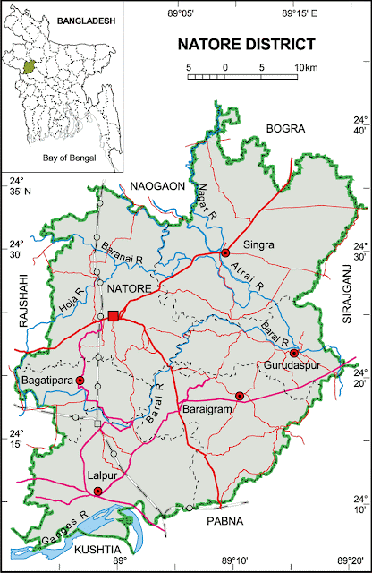
Natore District
A. Sales Universe: 5000
R SO: 872
Market Share: 17.44%
V SO:886
Market Share: 17.72%
O SO:593
Market Share: 11.86% X SO:323
Market Share: 6.46%
S SO:833
Market Share:16.66 %
T SO:269
Market Share:5.38 %
I SO:302
Market Share: 6.04%
Others:922
Market Share: 18.44%
B. Retail Univers:55
R WOD: 43
V WOD: 35
O WOD: 36
X WOD: 30 S WOD: 40
T WOD: 22
I WOD: 22
Others:44
C. BS Universe: 11
R BS: 2
R BS Share: 18.18%
V BS: 2
V BS Share: 18.18%
O BS: 1
O BS Share: 9.09%
X BS: 1
X BS Share: 9.09% S BS: 5
S BS Share: 45.45%
T BS: 00
I BS: 00
Others: 00
D. CS Univers:9
R CS: 7
R CS Share: 77.78%
V CS: 4
V CS Share: 44.44%
O CS: 3
O CS Share:33.33%
X CS: 2
X CS Share:22.22% S CS: 3
S CS Share:33.33%
T CS: 1
T CS Share:11.11%
I CS: 1
I CS Share:11.11%
Others: 5
Others CS Share: 45%
E. GRT Universe: 35
R GRT: 34
R GRT Share: 97.14%
V GRT: 29
V GRT Share: 82.85%
O GRT: 32
O GRT Share: 91.43%
X GRT: 27
X GRT Share:77.14 % S GRT: 32
S GRT Share:91.43%
T GRT: 21
T GRT Share:60%
I GRT: 21
I GRT Share:60%
Others: 39
Others GRT Share:100%
G. R RSM: 1
R ASM: 1
R TSM: 1
V RSM: 1
V ASM: 1
V TSM: 1
O RSM: 1
O ASM: 1
O TSM: 1
X RSM: 1
X ASM: 1
X TSM: 1
S RSM: 1
S ASM: 1
S TSM: 1
T RSM: 1
T ASM: 1
T TSM: 0
I RSM: 1
I ASM: 1
I TSM: 1
F. realme Dealer: 1
TTL Investment: 90Lac
Inventory: 64 Lac
Market due: 7 Lac
Natore District (7 Thana)

Slide 2
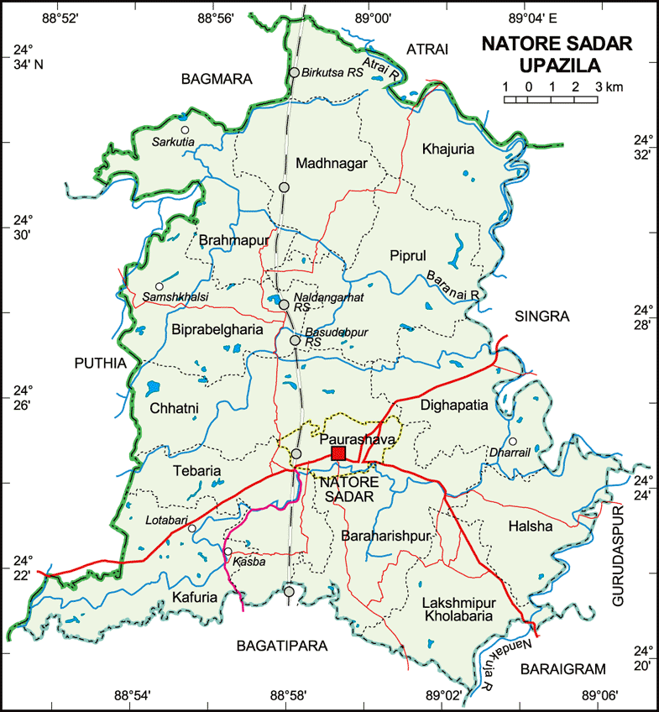
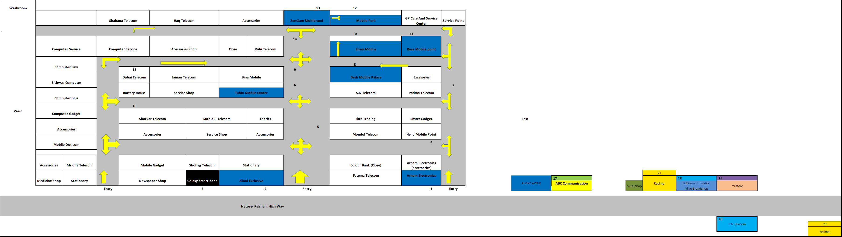
Natore_Sadar Market:
C. BS Universe: 10
R BS: 2 (95pcs)
R BS Share: 20%
V BS: 2 (32pcs)
V BS Share: 20%
O BS: 1 (41pcs)
O BS Share: 10% X BS: 1 (38pcs)
X BS Share: 10%
S BS: 4 (74pcs)
S BS Share: 40%
T BS: 00 (00pcs)
I BS: 00 (00pcs)
Other: 00 (00pcs)
D. CS Universe: 7
R CS: 3 (85 pcs)
R CS Share: 42.85%
V CS-4 (50pcs)
V CS Share: 42.85%
O CS-2 (42pcs)
O CS Share: 28.57% X CS: 1 (30pcs)
X CS Share: 14.28%
S CS: 2 (45pcs)
S CS Share: 28.57%
T CS: 01 (32pcs)
T CS Share: 14.28%
I CS: 01 (30pcs)
I CS Share: 14.28%
Other: 5 (55pcs)
Others CS Share: 71.42%
E. GRT Universe: 8
R GRT: 8(8pcs)
R GRT Share: 100%
V GRT: 8(10 pcs)
V GRT Share: 100%
O GRT:8(7pcs)
O GRT Share: 100% X GRT: 8(5 pcs)
X GRT Share: 100%
S GRT: 8 (6pcs)
S GRT Share: 100%
T GRT: 6 (3pcs)
T GRT Share: 75%
I GRT: 7 (5pcs)
I GRT Share: 87.5%
Other: 8 (5pcs)
Others GRT Share: 100%
A. Market Review:
Sales Universe: 2368
R SO: 397
R MKT Share: 16.78%
V SO:407
V MKT Share:17.20%
O SO:282
O MKT Share:11.90% X SO:167
X MKT Share:7.05%
S SO:512
S MKT Share:21.64%
T SO:94
T MKT Share:3.97%
I SO:130
I MKT Share:5.48%
Other:579
I MKT Share:16%
B. Retail Universe: 23
R WOD: 13
V WOD-13
O WOD: 14
X WOD: 10 S WOD:14
T WOD: 7
I WOD: 8
Others WOD: 13
F. realme Dealer: 1
TTL Investment: 90Lac
Inventory:22 Lac
TTL Market due: 7Lac Sadar Market Due: 1.5 lac
G. realme RSM: 1
realme ASM: 1
TSM: 1
Main market – Natore Distance
Market Map – Sadar Thana

Slide 3
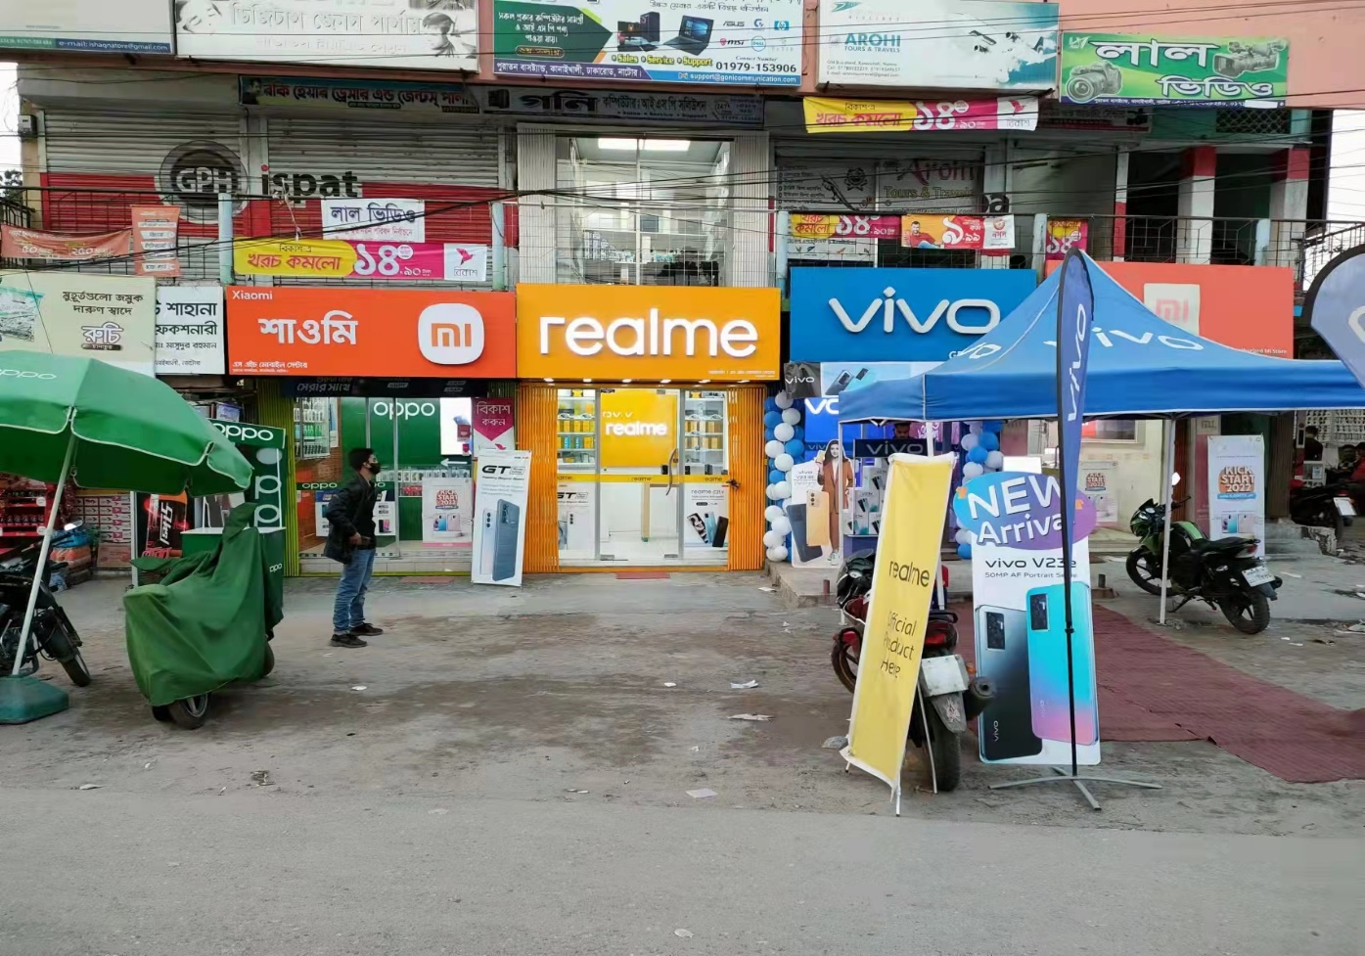
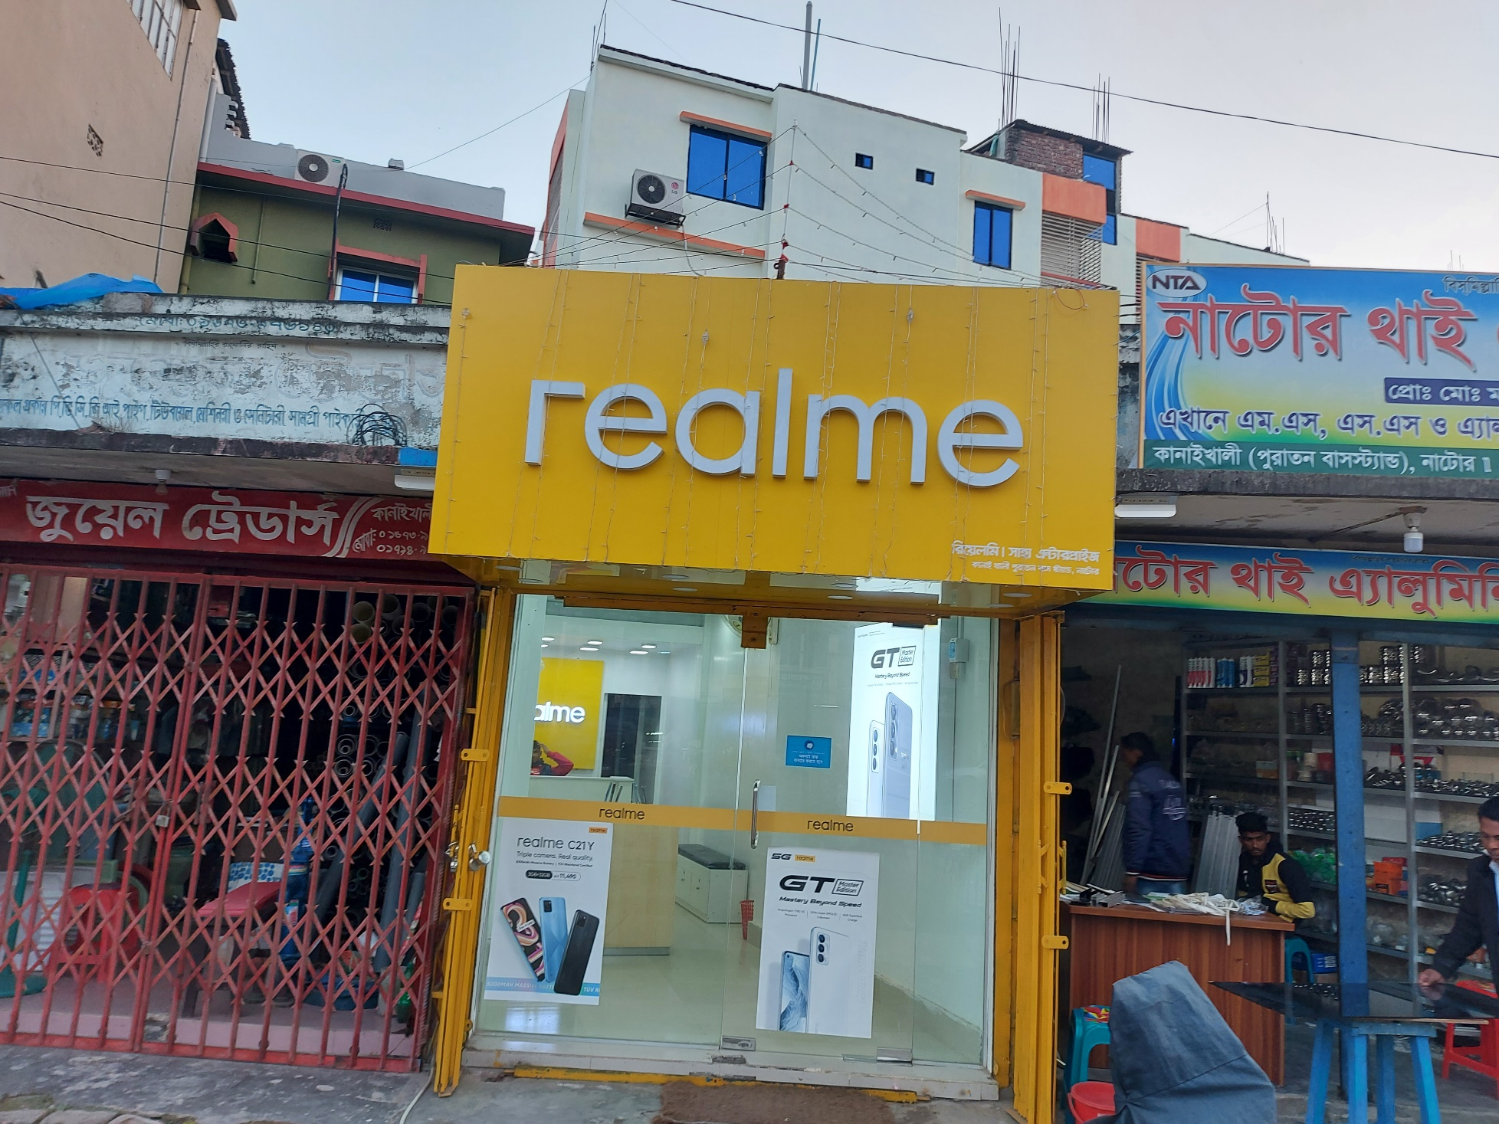
Natore Sadar Market (Realme BS)
SH Mobile Center Showroom:
Sales Universe: 82
R SO: 82
Saha Enterprise Showroom:
Sales Universe: 100
R SO: 100

Slide 4
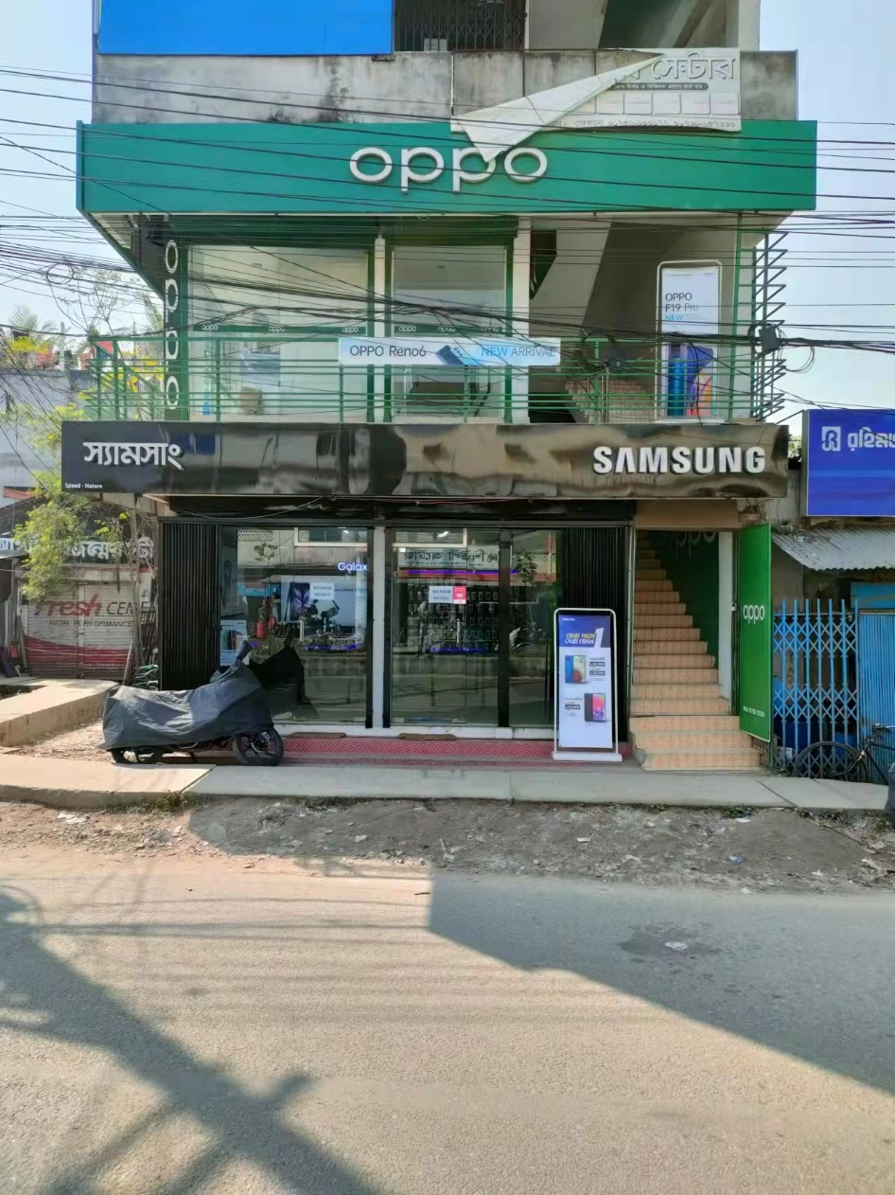
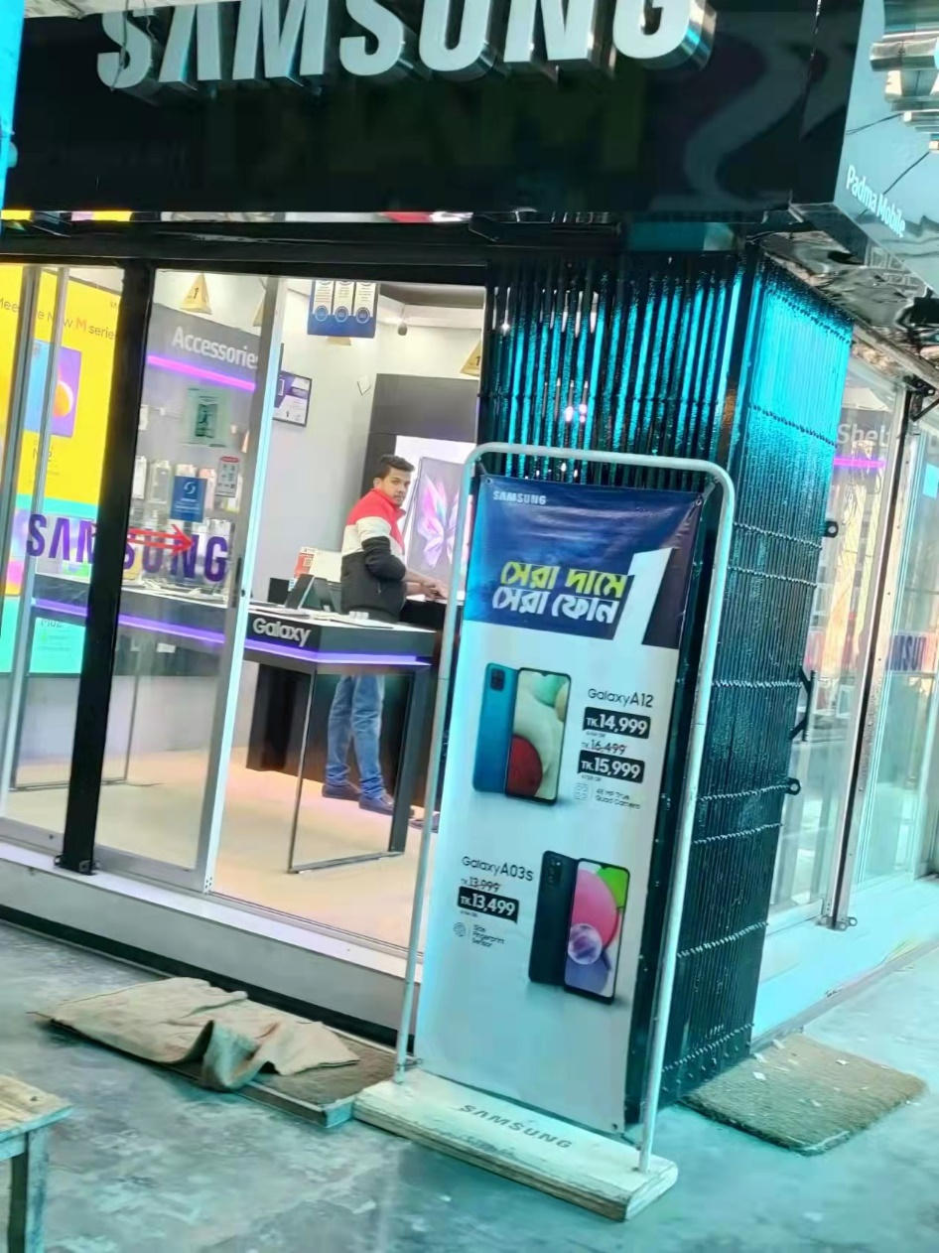
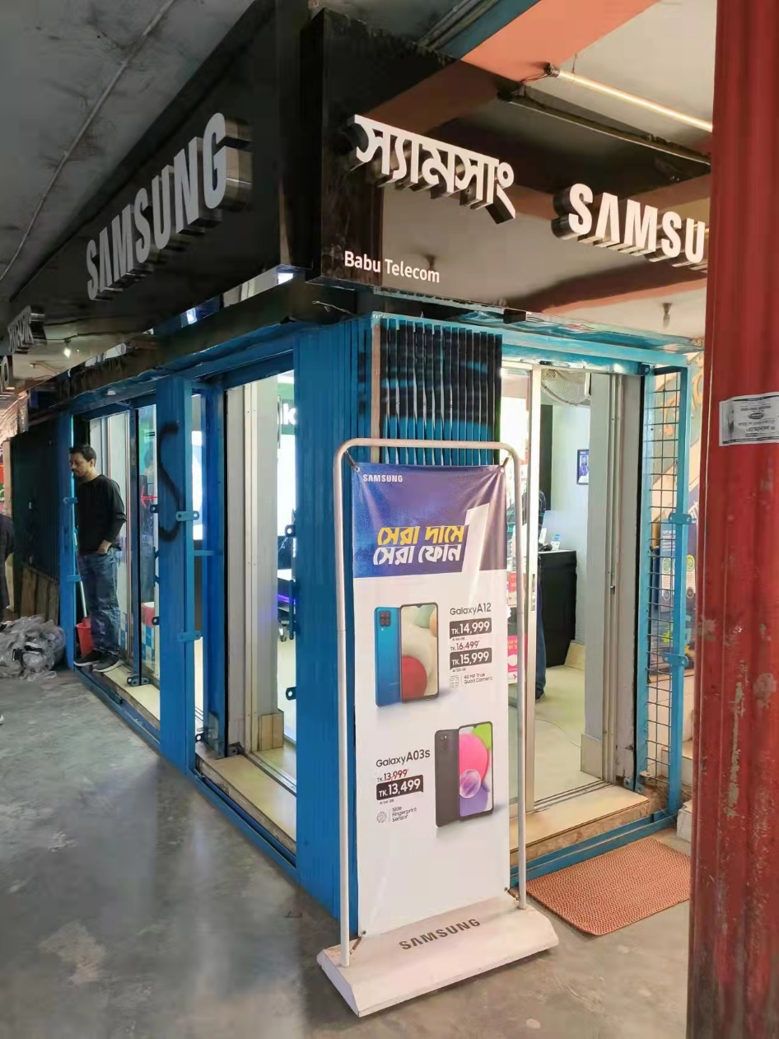
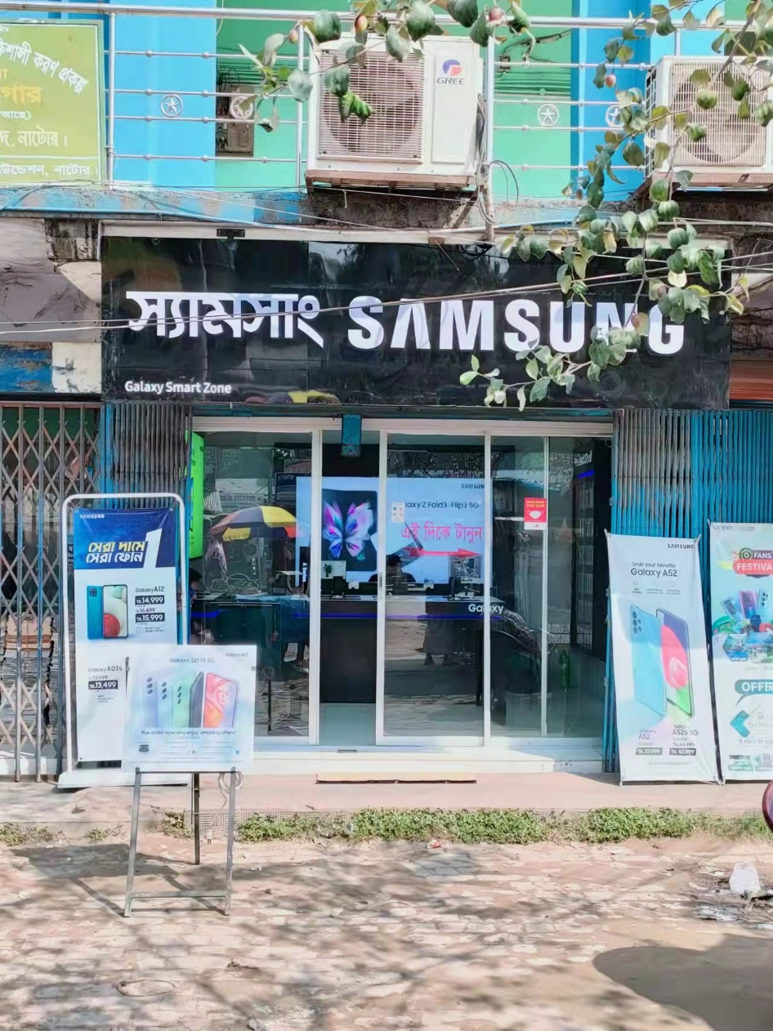
Natore Sadar Market (Samsung BS)
Speed Natore:
Sales Universe: 71
S SO: 71
Padma-Mobile:
Sales Universe: 76
S SO: 76
Nabila Telecom:
Sales Universe: 46
S SO: 46
Galaxy Smart Zone:
Sales Universe: 50
S SO: 50

Slide 5

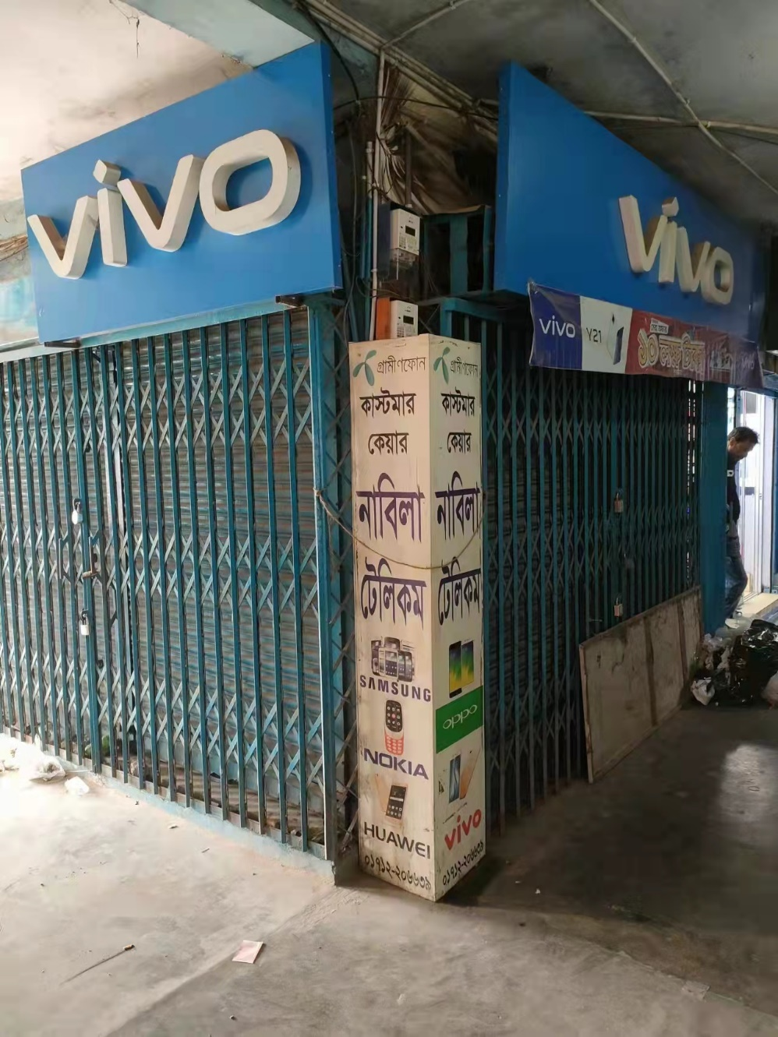
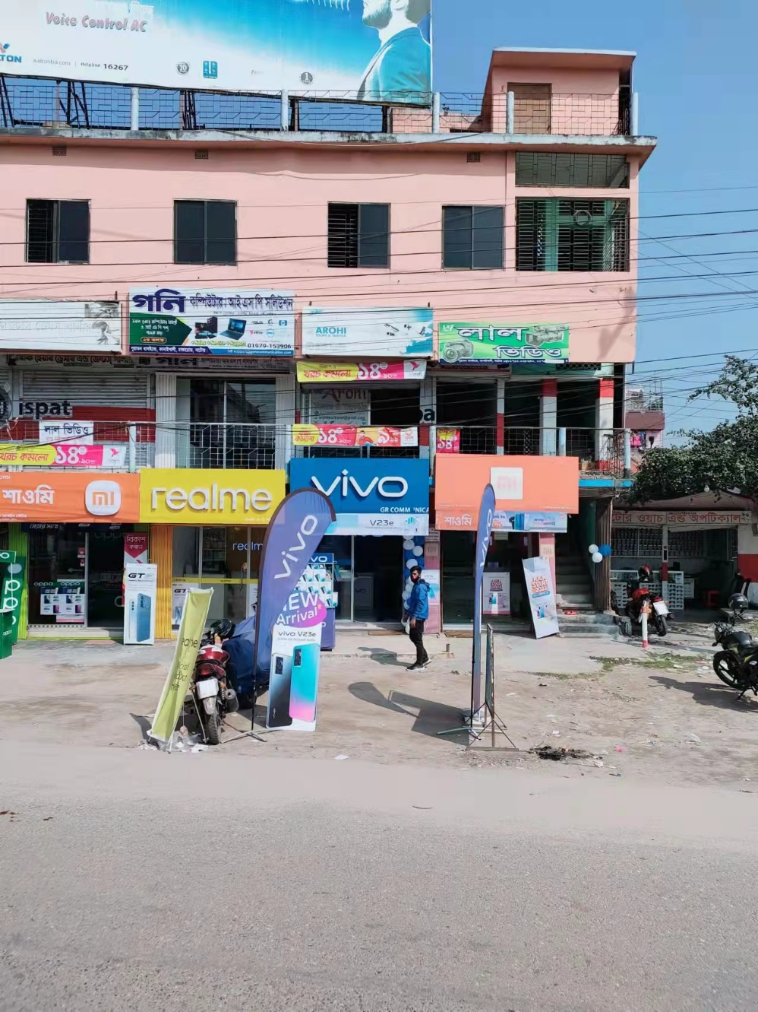
Natore Sadar Market (MI, Vivo, Oppo BS)
Wasif Telecom:
Oppo Brand Showroom
Sales Universe: 35
O SO: 35
Himig Brandshop:
Vivo Brand Showroom
Sales Universe: 18
V SO: 18
GR Communication: Vivo Brand Showroom
Sales Universe: 40
V SO: 40
GR Communication:
MI Brand Showroom
Sales Universe: 31
X SO: 31

Slide 6
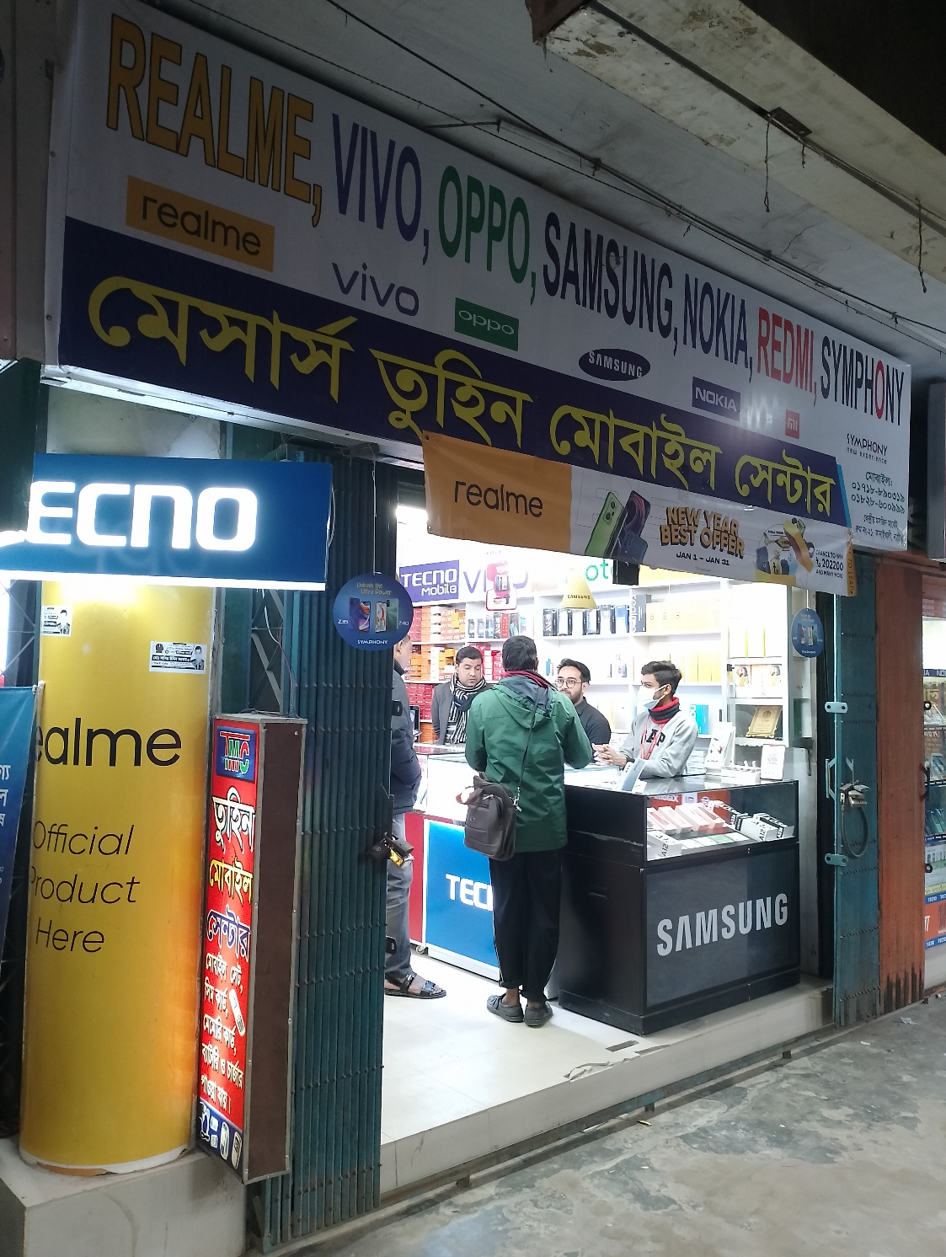
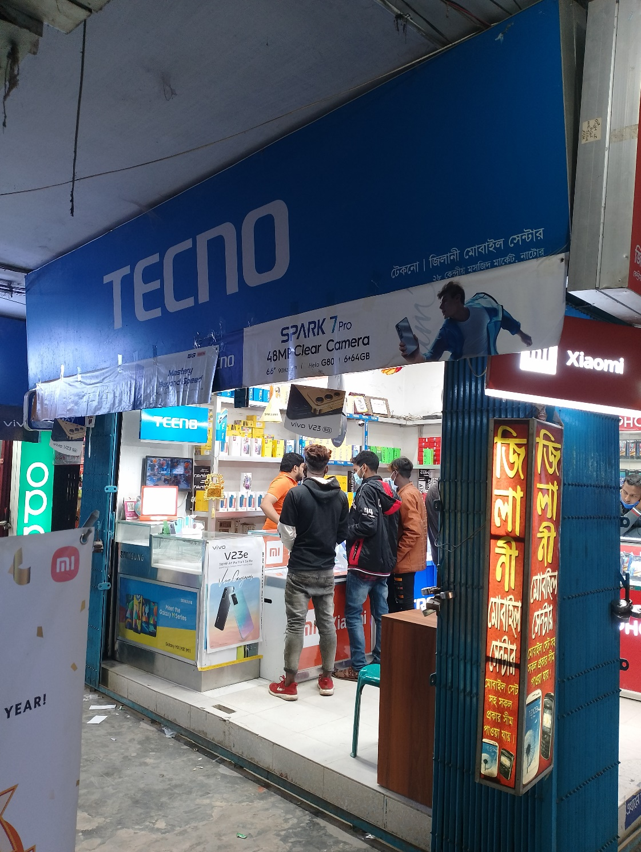
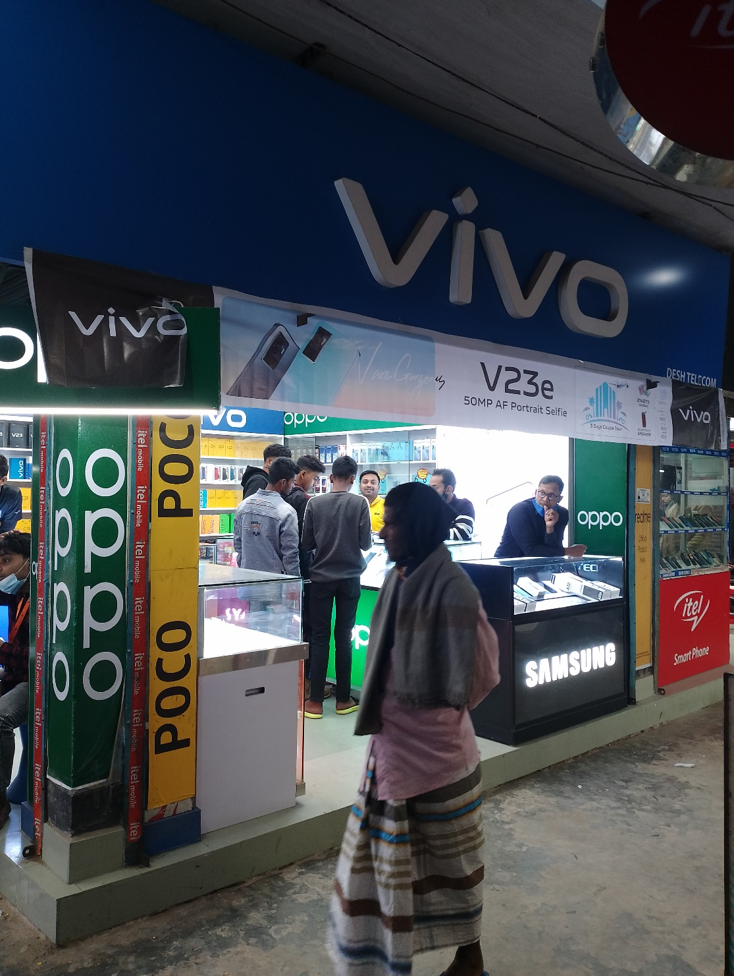
Natore Sadar Market (CS)
CS Shop:
TTL 3 realme Cs Shop
TTL CS Sale: 255
Average Sale:85 pcs
Plan: Need to Bell Sign/
Some Sticker Branding
Tuhin Mobile:
Sales Universe: 320
R SO: 78
V SO: 19
O SO: 51
S SO:34
X SO: 24
T SO: 28
I SO: 16
Others: 70
Zilani Exclusive:
Sales Universe:381
R SO: 102
V SO: 49
O SO: 32
S SO:42
X SO: 30
T SO: 32
I SO: 21
Others:73
Desh Telecom:
Sales Universe:239
R SO: 75
V SO: 25
O SO: 26
S SO:15
X SO:27
T SO: 9
I SO: 18
Others: 44

Slide 7
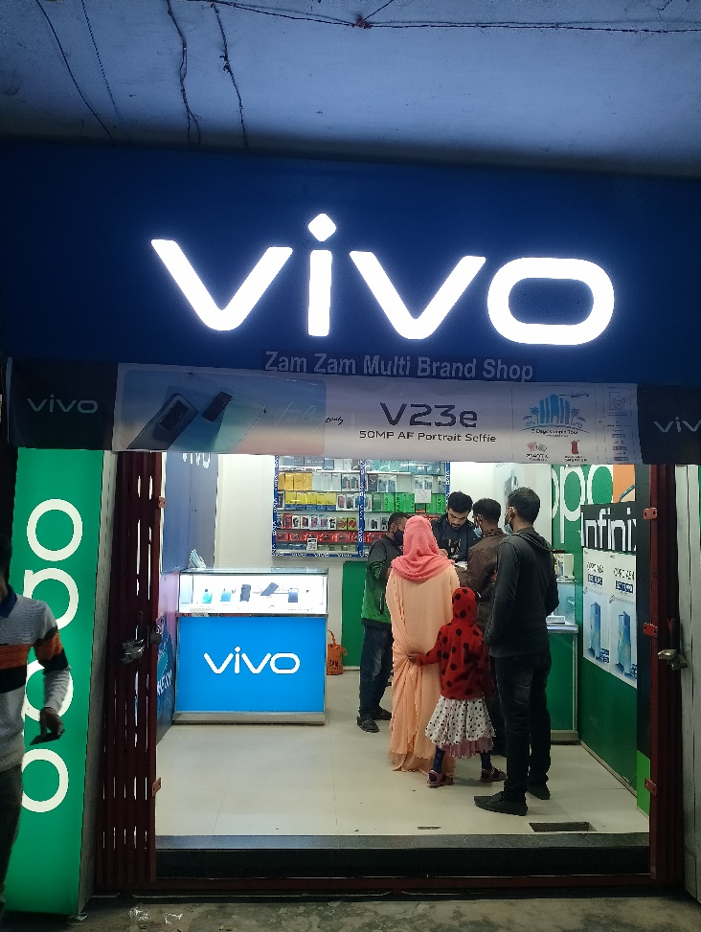
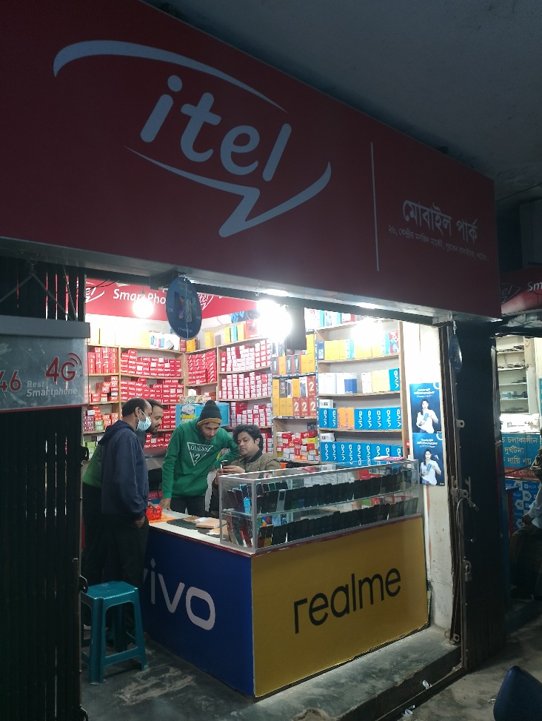
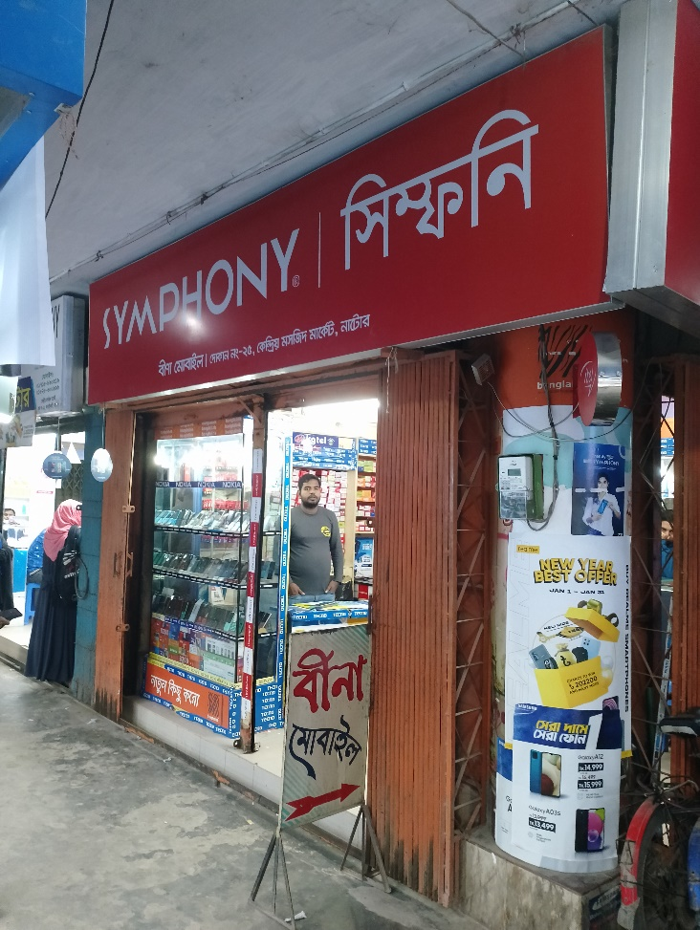
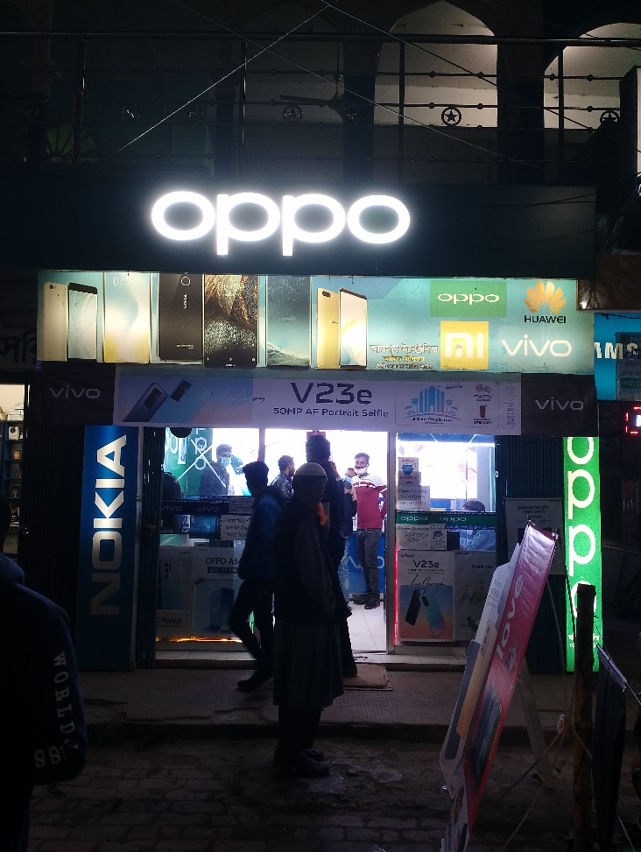
Natore Sadar Market (GRT)
Zam Zam Multi Brand Sales Universe:
R SO: 4
V SO: 30
O SO: 24
S SO:13
X SO: 5
T SO: 0
I SO: 16
Others: 3
Mobile Park:
Sales Universe:381
R SO: 5
V SO: 11
O SO: 8
S SO:10
X SO: 9
T SO: 9
I SO: 16.67
Others:46
Bina Mobile:
Sales Universe:239
R SO: 8
V SO: 0
O SO: 6
S SO:5
X SO:0
T SO: 3
I SO: 11
Others: 20
Arham Electronics:
Sales Universe:239
R SO: 4
V SO: 51
O SO: 20
S SO:37
X SO:3
T SO: 8
I SO: 0
Others: 0
GRT Shop:
TTL 8 realme GRT Shop
TTL GRT Sale:820 Pcs
Plan: Some Sticker Branding

Slide 8
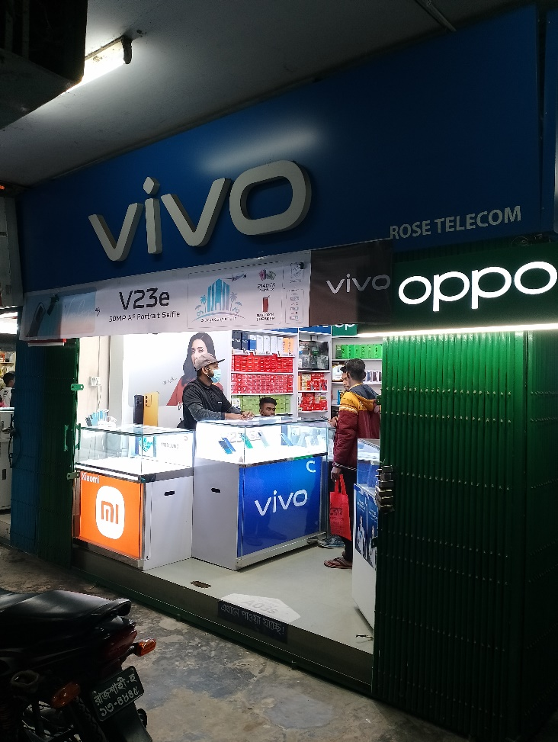
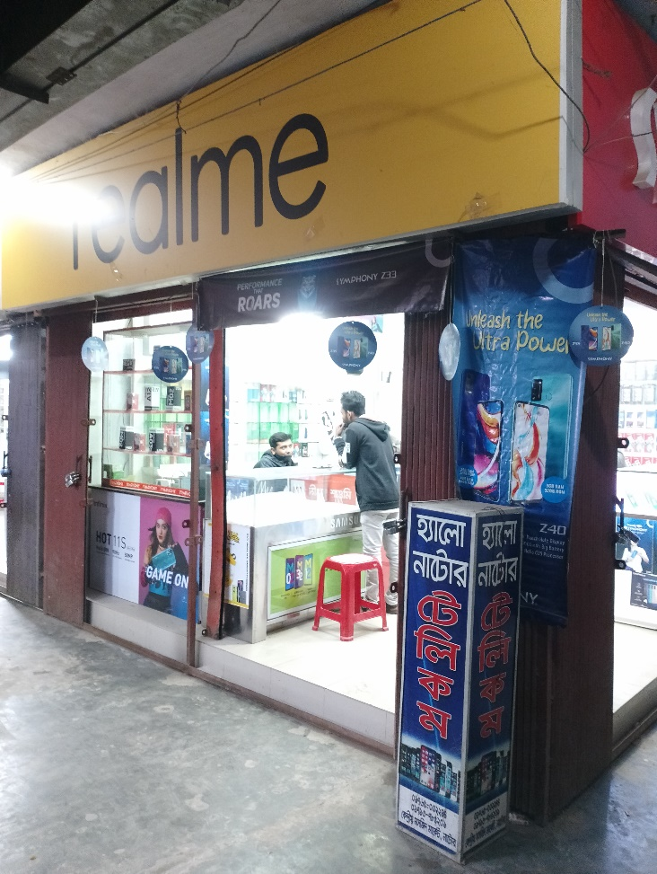
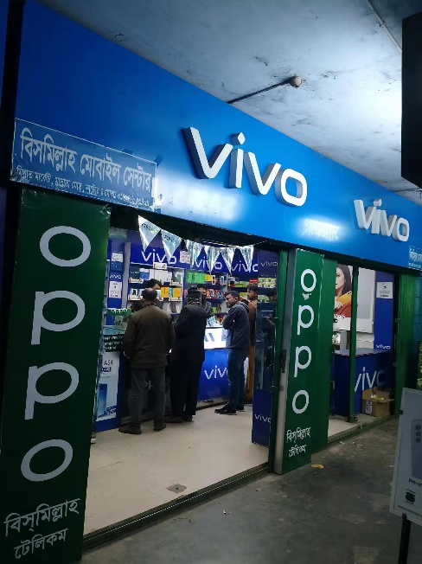
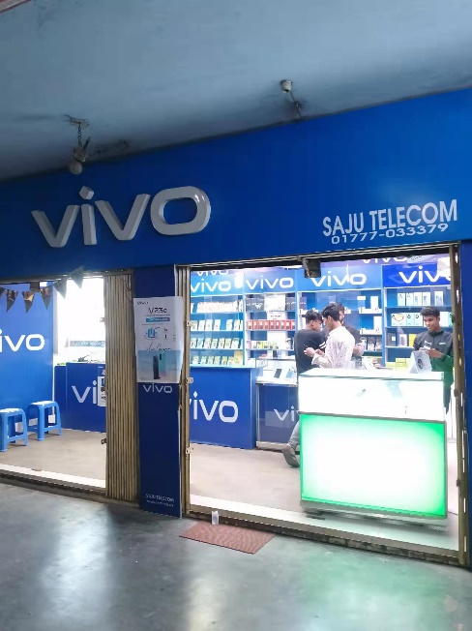
Natore Sadar Market (GRT)
Rose Mobile :
Sales Universe:
R SO: 6
V SO: 31
O SO: 14
S SO:20
X SO: 19
T SO: 11
I SO: 19
Others: 65
Hello Natore:
Sales Universe:
R SO: 5
V SO: 7
O SO: 2
S SO:0
X SO: 0
T SO: 0
I SO: 22
Others:62
Bismillah Mobile:
Sales Universe:239
R SO: 8
V SO: 27
O SO: 25
S SO:13
X SO:9
T SO: 0
I SO: 2
Others:17
Saju Telecom:
Sales Universe:239
R SO: 5
V SO: 30
O SO: 11
S SO:0
X SO:5
T SO: 0
I SO: 1
Others: 16
GRT Shop:
TTL 8 realme GRT Shop
TTL GRT Sale:820 Pcs
Plan: Some Sticker Branding

Slide 9
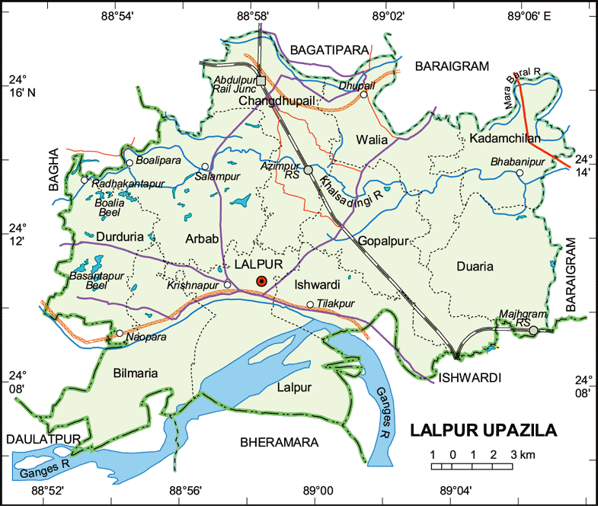
Lalpur Thana Market:
A. Market Review:
Sales Universe: 450
R SO: 100
R MKT Share: 22.22%
V SO:67
V MKT Share:14.89%
O SO:70
O MKT Share:15.55% X SO:19
X MKT Share:4.22%
S SO:39
S MKT Share:8.66%
T SO:52
T MKT Share:11.56%
I SO:15
I MKT Share:3.33%
Other:88
I MKT Share:19.55%
B. Retail Universe: 4
R WOD: 4
V WOD-4
O WOD: 4
X WOD: 4 S WOD:4
T WOD: 4
I WOD: 4
Others WOD: 4
C. BS Universe: 0
R BS: 0
R BS Share: 0
V BS: 0
V BS Share: 0
O BS: 0
O BS Share:0 X BS: 0
X BS Share:0
S BS: 0
S BS Share:0
T BS:0
I BS: 0
Other: 0
D. CS Universe: 2
R CS: 2 (94 pcs)
R CS Share: 100%
V CS :1 (42 pcs)
V CS Share: 50%
O CS:1 (40 pcs)
O CS Share: 50% X CS: 0
X CS Share: 0
S CS: 0
S CS Share: 0
T CS: 0
T CS Share: 0
I CS: 0
I CS Share: 0
Other: 0
Others CS Share:0
E. GRT Universe: 2
R GRT: 2(6pcs)
R GRT Share: 100%
V GRT: 3(10 pcs)
V GRT Share: 100%
O GRT:3(31pcs)
O GRT Share: 100% X GRT: 4(9 pcs)
X GRT Share: 100%
S GRT: 4(39 pcs)
S GRT Share: 100%
T GRT: 4 (38pcs)
T GRT Share: 100%
I GRT: 4 (15pcs)
I GRT Share: 100%
Other: 4 (86pcs)
Others GRT Share: 100%
F. realme Dealer: 1
TTL Investment: 90Lac
Inventory:12 Lac
TTL Market due: 7Lac
Lalpur Market Due: 3.5 lac
G. realme RSM: 1
realme ASM: 1
TSM: 1
Main market – Natore Distance
Market Map – Lalpur Thana

Slide 10
Lalpur Thana Market (BS)
No Brand shop

Slide 11
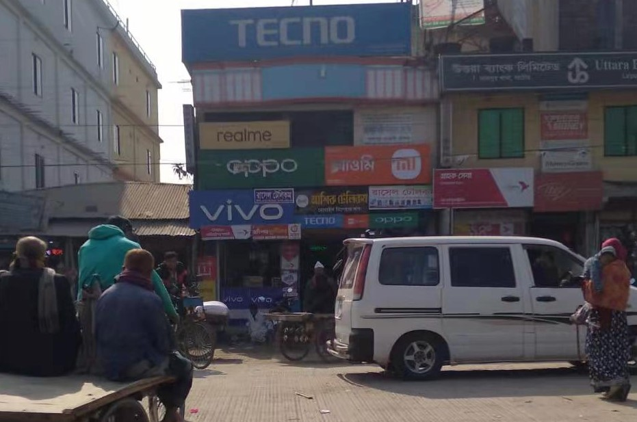
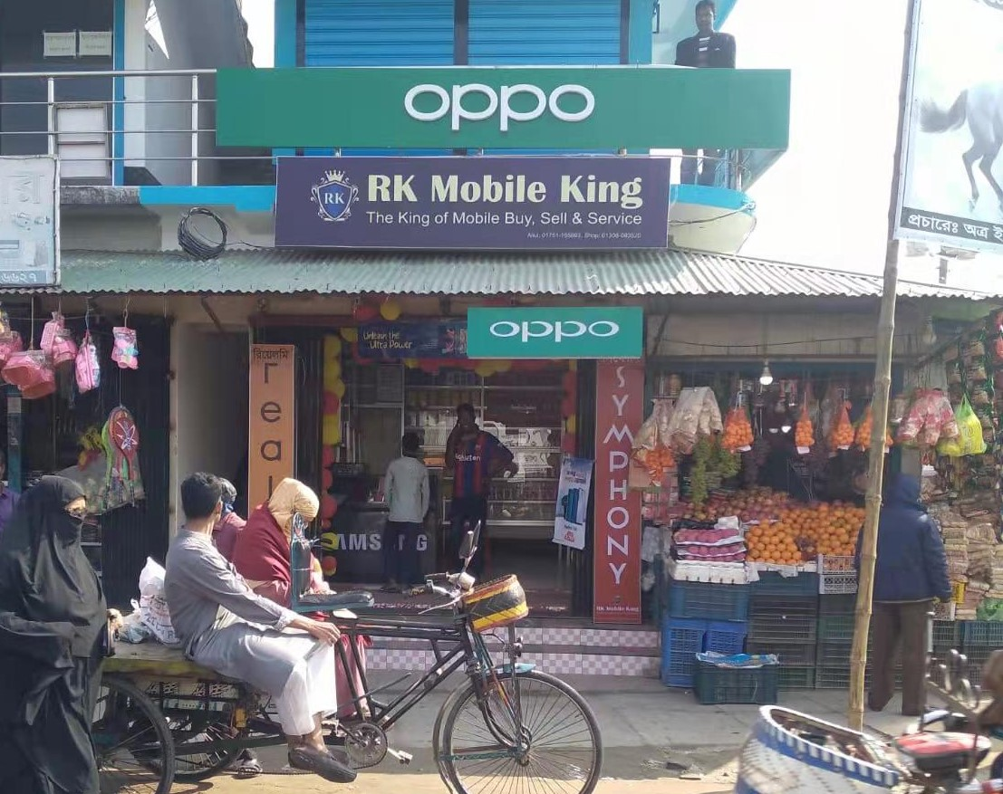
Lalpur Thana Market (CS)
Rasel Telecom:
Sales Universe: 221
R SO: 55
V SO: 41
O SO: 40
S SO:18
X SO: 22
T SO: 15
I SO: 13
Others: 17
Kabir Telecom Lalpur:
Sales Universe: 100
R SO: 40
V SO: 4
O SO: 5
S SO:12
X SO: 5
T SO: 5
I SO: 4
Others: 25
CS Shop:
TTL 2 realme Cs Shop
TTL CS Sale: 94
Average Sale:74 pcs
Plan: Need to Signboard , Shilling Light box

Slide 12
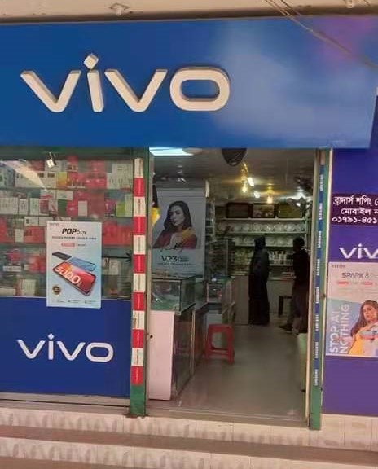
Lalpur Thana Market (GRT)
Brothers Mobile:
Sales Universe:36
R SO: 5
V SO: 10
O SO: 3
S SO:4
X SO:2
T SO: 1
I SO: 1
Others:10
GRT Shop:
TTL 8 realme GRT Shop
TTL GRT Sale:820 Pcs
Plan: Some Sticker Branding

Slide 13
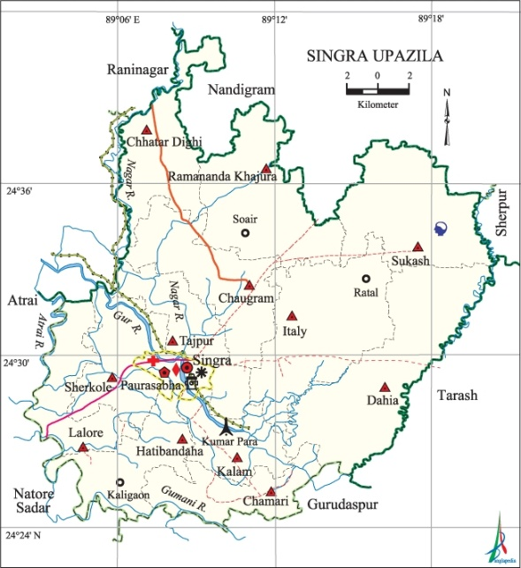
Singra Thana Market:
A. Market Review
Sales Universe: 409
R SO: 72
R MKT Share: 17.60%
V SO:57
V MKT Share:13.93%
O SO:38
O MKT Share:9.29% X SO:35
X MKT Share:8.55%
S SO:84
S MKT Share:20.53%
T SO:17
T MKT Share:1.71%
I SO:30
I MKT Share:7.33%
Other:76
I MKT Share:18.58%
B. Retail Universe: 5
R WOD: 2
V WOD-2
O WOD: 2
X WOD: 2 S WOD:3
T WOD: 2
I WOD: 2
Others WOD: 5
C. BS Universe: 1
R BS: 0
R BS Share: 0
V BS: 0
V BS Share: 0
O BS: 0
O BS Share:0 X BS: 0
X BS Share:0
S BS: 1
S BS Share:100%
T BS:0
I BS: 0
Other: 0
D. CS Universe: 1
R CS: 1 (50 pcs)
R CS Share: 100%
V CS:0
V CS Share:
O CS:0
O CS Share:0 X CS: 0
X CS Share: 0
S CS: 0
S CS Share: 0
T CS: 0
T CS Share: 0
I CS: 0
I CS Share: 0
Other: 0
Others CS Share:0
E. GRT Universe: 4
R GRT: 1(22pcs)
R GRT Share: 20%
V GRT: 2(57pcs)
V GRT Share: 40%
O GRT:2(38pcs)
O GRT Share: 40% X GRT: 2(35 pcs)
X GRT Share: 40%
S GRT: 2(30 pcs)
S GRT Share: 40%
T GRT: 2 (17pcs)
T GRT Share: 40%
I GRT: 2 (30pcs)
I GRT Share: 40%
Other: 4 (76pcs)
Others GRT Share:80%
F. realme Dealer: 1
TTL Investment: 90Lac
Inventory: 3.5 Lac
TTL Market due: 7Lac
Lalpur Market Due: .5 lac
G. realme RSM: 1
realme ASM: 1
TSM: 1
Main market – Natore Distance
Market Map –Singra Thana

Slide 14
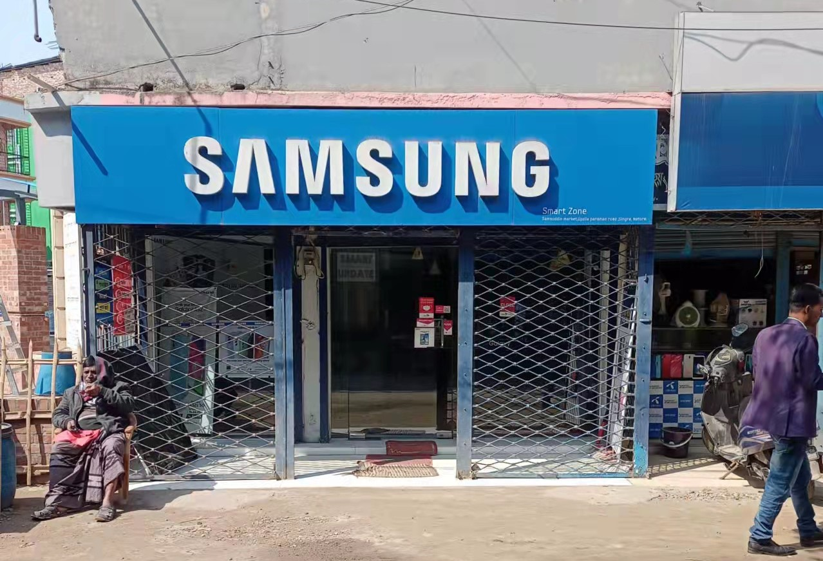
Singra Thana Market (BS)
Smart Zone Samsung Brand Showroom:
Sales Universe: 55
S SO: 55

Slide 15
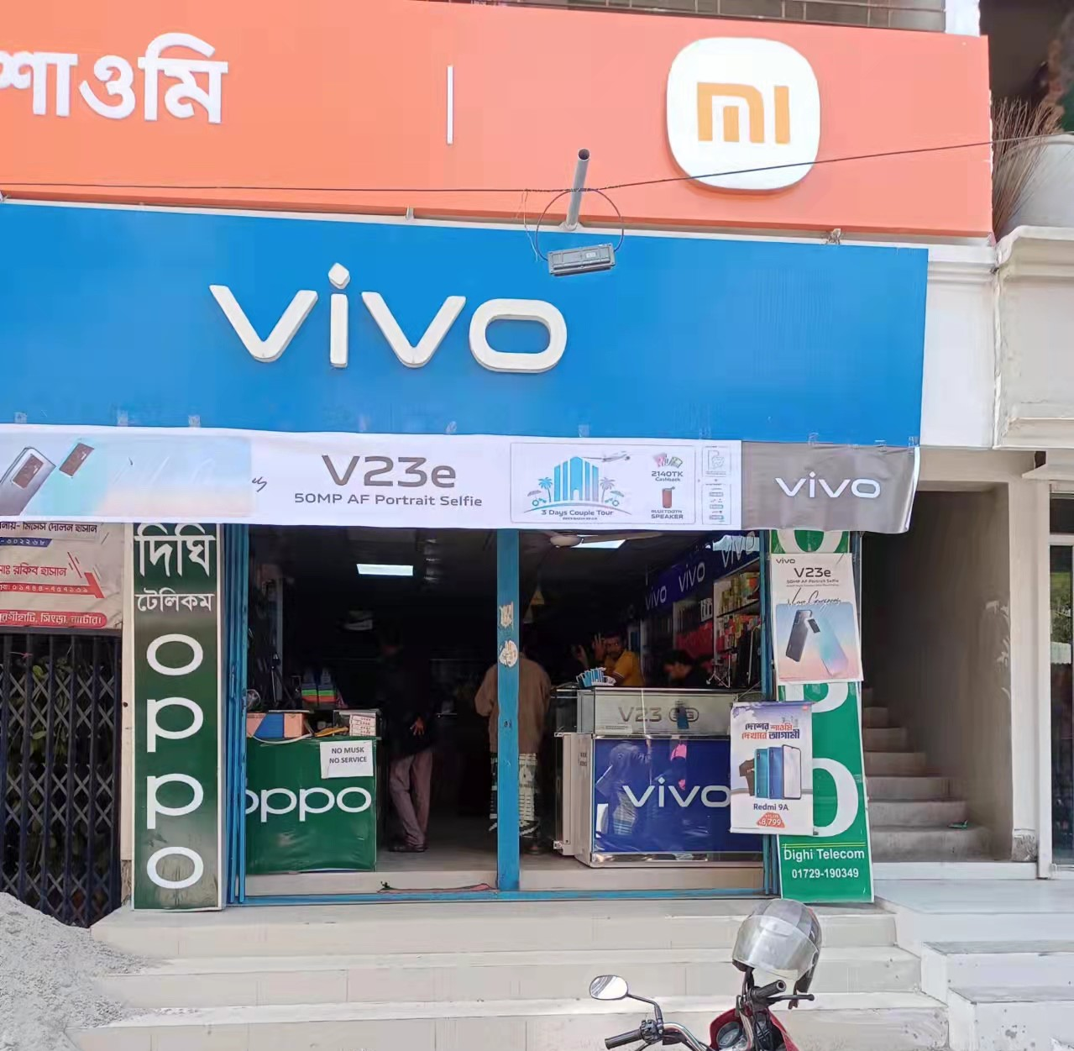
Singra Thana Market (CS)
Dighe Telecom:
Sales Universe: 206
R SO: 50
V SO: 37
O SO: 27
S SO:22
X SO: 17
T SO: 15
I SO: 13
Others: 25
CS Shop:
TTL 2 realme Cs Shop
TTL CS Sale: 206
Average Sale:206 pcs
Plan: Need to Signboard , Shilling Light box

Slide 16
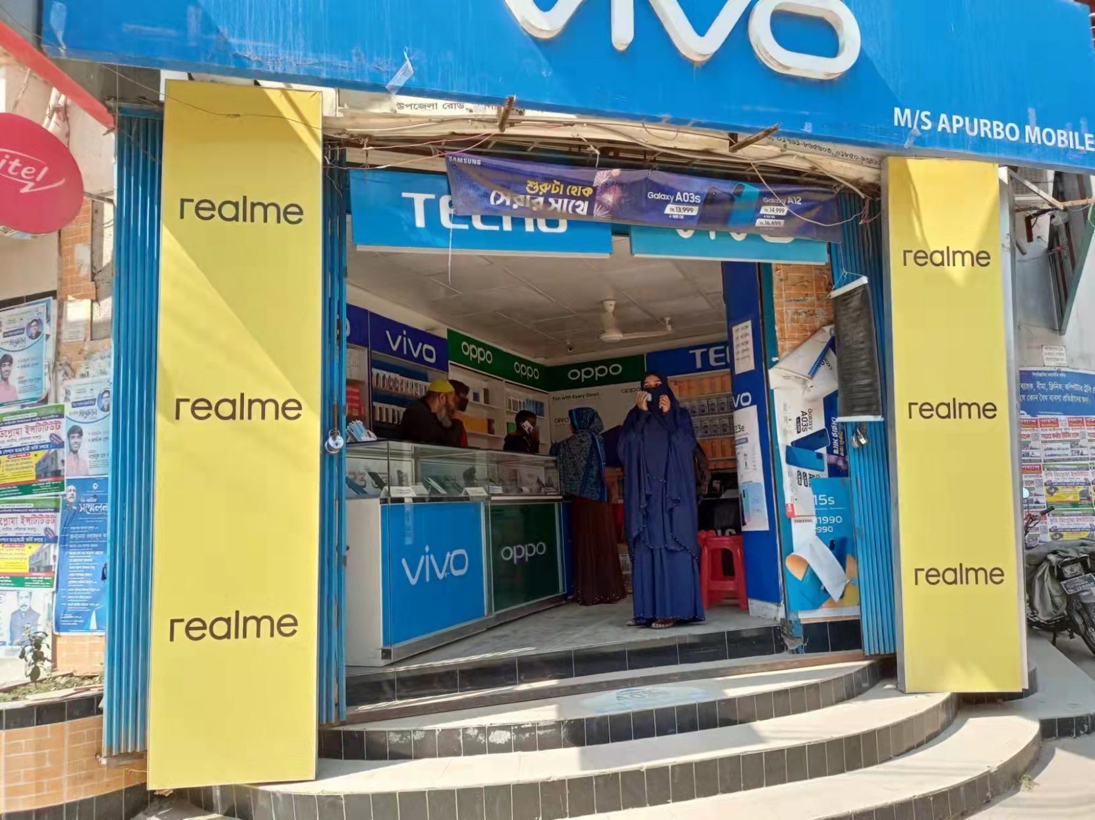
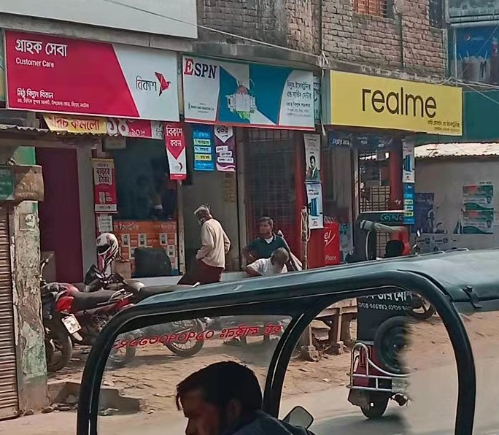
Singra Thana Market (GRT)
Apurbo Mobile :
Sales Universe: 115
R SO: 15
V SO: 16
O SO: 20
S SO:17
X SO: 12
T SO: 10
I SO: 5
Others: 20
Shafi Mobile:
Sales Universe:22
R SO: 5
V SO: 0
O SO: 2
S SO:3
X SO:2
T SO: 2
I SO: 1
Others: 7
CS Shop:
TTL 2 realme GRT Shop
TTL GRT Sale:305Pcs
Plan: Need to Bell Sign, Shilling Light box

Slide 17
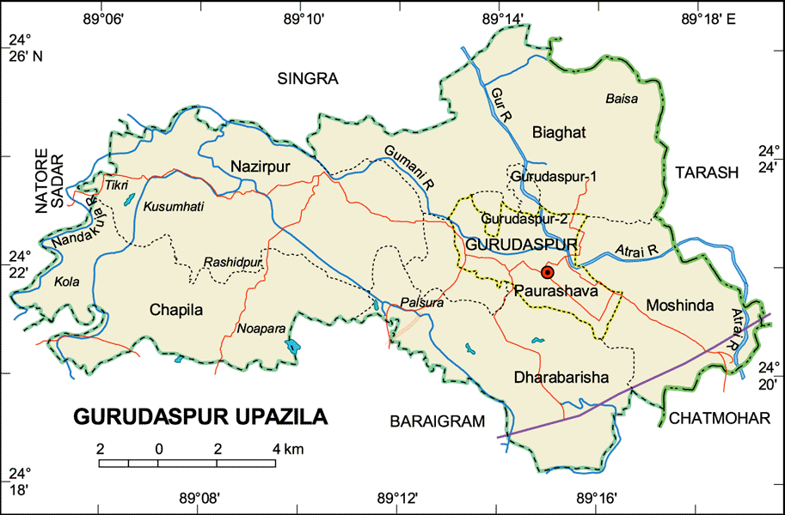
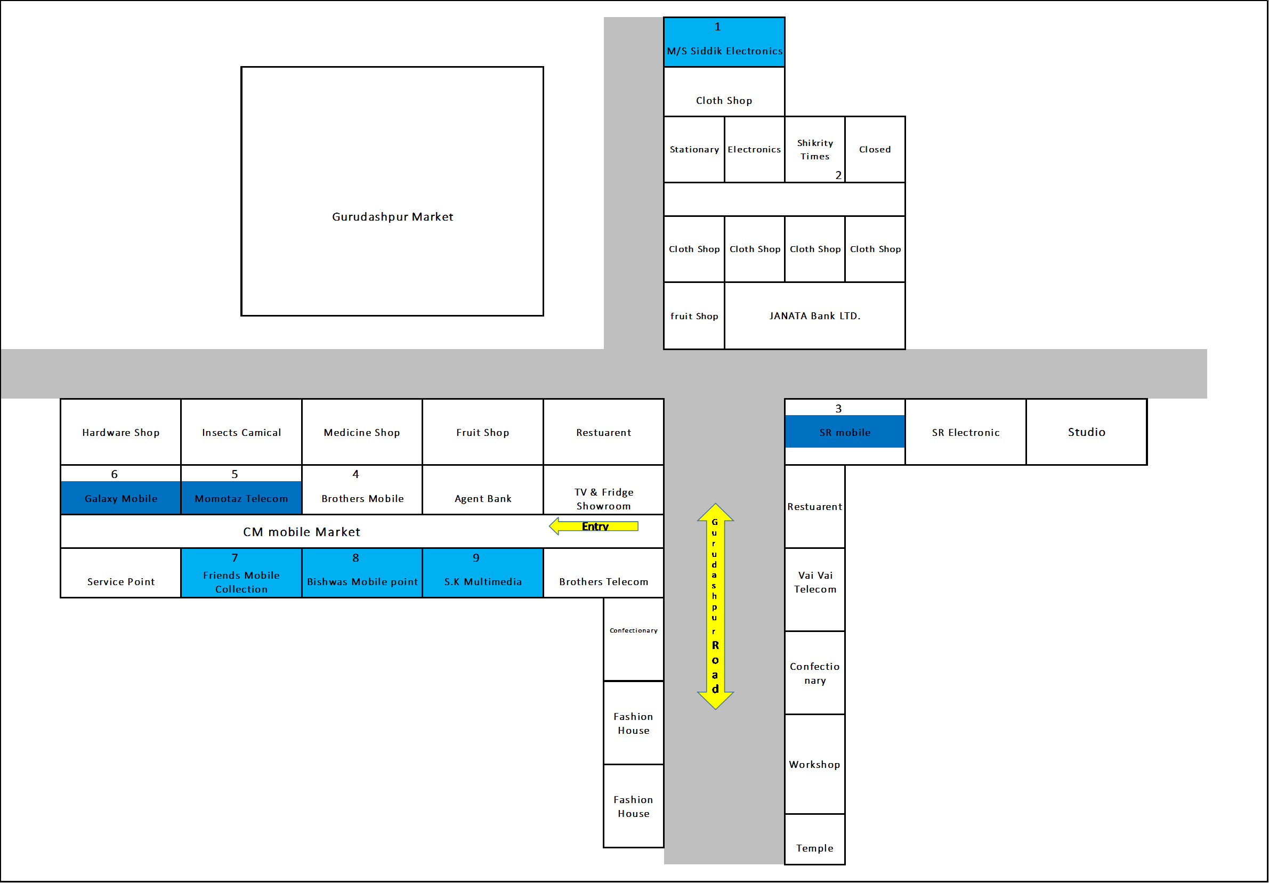
Gurudaspur Thana Market:
A. Market Review
Sales Universe: 726
R SO: 147
R MKT Share:20.24 %
V SO:90
V MKT Share12.39:%
O SO:78
O MKT Share:10.74% X SO:35
X MKT Share:4.82%
S SO:67
S MKT Share:9.22%
T SO:29
T MKT Share:3.93%
I SO:95
I MKT Share:13.08%
Other:185
I MKT Share:25.48%
B. Retail Universe: 8
R WOD: 8
V WOD-8
O WOD: 8
X WOD: 8 S WOD:8
T WOD: 8
I WOD: 8
Others WOD: 8
C. BS Universe: 0
R BS: 0
R BS Share: 0
V BS: 0
V BS Share: 0
O BS: 0
O BS Share:0 X BS: 0
X BS Share:0
S BS: 0
S BS Share:0
T BS:0
I BS: 0
Other: 0
D. CS Universe: 2
R CS: 2 (103 pcs)
R CS Share: 100%
V CS:0
V CS Share:
O CS:0
O CS Share:0 X CS: 0
X CS Share: 0
S CS: 0
S CS Share: 0
T CS: 0
T CS Share: 0
I CS: 0
I CS Share: 0
Other: 0
Others CS Share:0
E. GRT Universe: 6
R GRT: 6(44pcs)
R GRT Share: 100%
V GRT: 8(90pcs)
V GRT Share: 100%
O GRT:8(78pcs)
O GRT Share: 100% X GRT: 8(35 pcs)
X GRT Share: 100%
S GRT: 8(67 pcs)
S GRT Share: 100%
T GRT: 8 (29pcs)
T GRT Share: 100%
I GRT: 8(95pcs)
I GRT Share: 100%
Other: 8 (185pcs)
Others GRT Share:100%
F. realme Dealer: 1
TTL Investment: 90Lac
Inventory: 11.5 Lac
TTL Market due: 7Lac
Lalpur Market Due: .5 lac
G. realme RSM: 1
realme ASM: 1
TSM: 1
Main market – Natore Distance
Market Map –Gurudaspur Thana

Slide 18
Gurudaspur Thana Market (BS)
No Brand shop

Slide 19
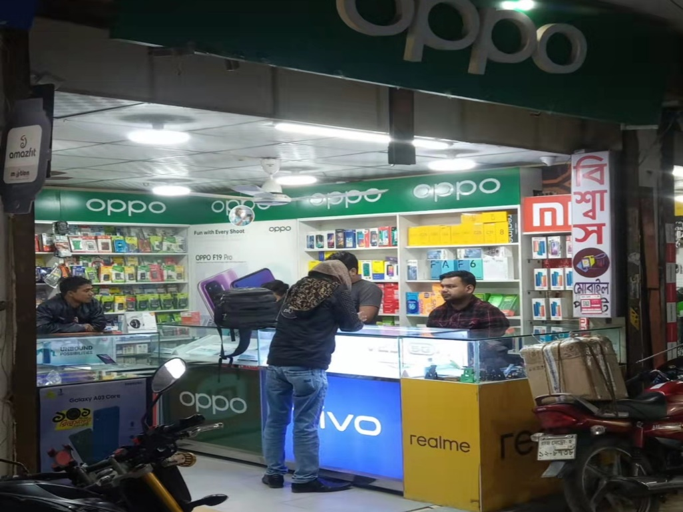
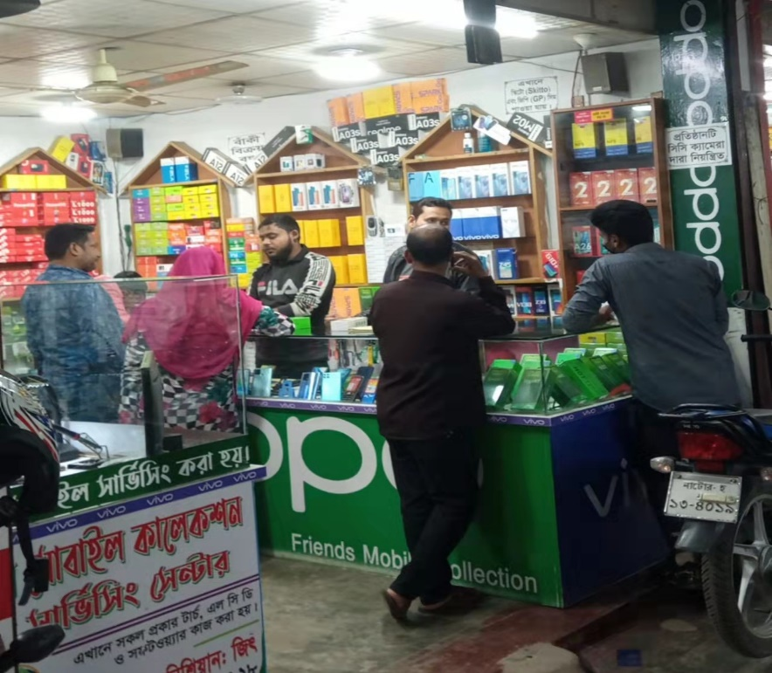
Gurudaspur Thana Market (CS)
Biswas Mobile :
Sales Universe: 183
R SO: 60
V SO: 27
O SO: 20
S SO:27
X SO: 12
T SO: 7
I SO: 5
Others: 25
Friends Mobile:
Sales Universe: 122
R SO: 45
V SO: 15
O SO: 12
S SO:13
X SO:5
T SO: 4
I SO: 3
Others: 25
CS Shop:
TTL 2 realme GRT Shop
TTL GRT Sale:305Pcs
Plan: Need to Bell Sign, Shilling Light box

Slide 20
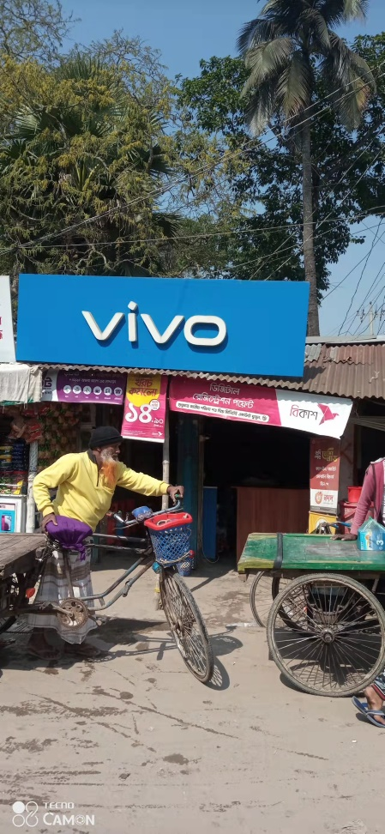
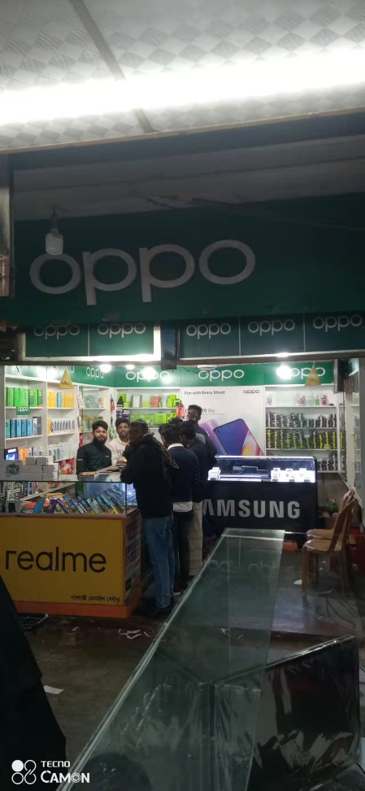
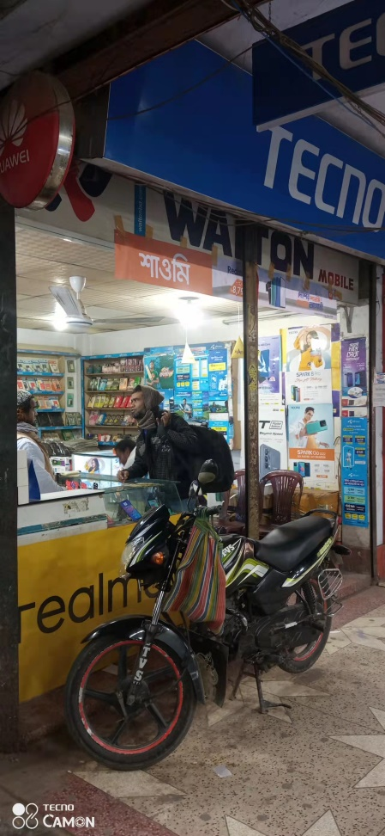
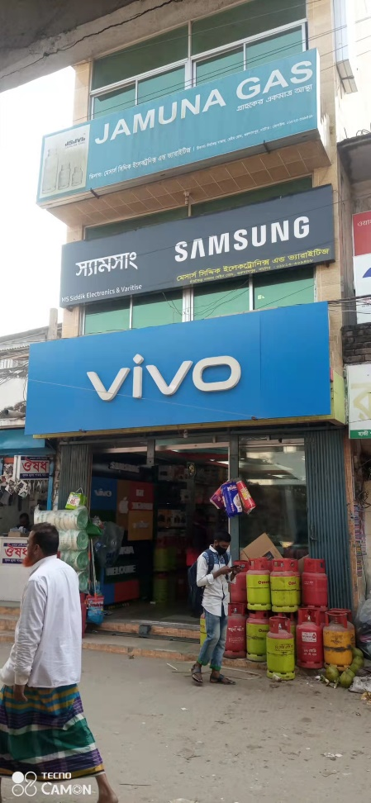
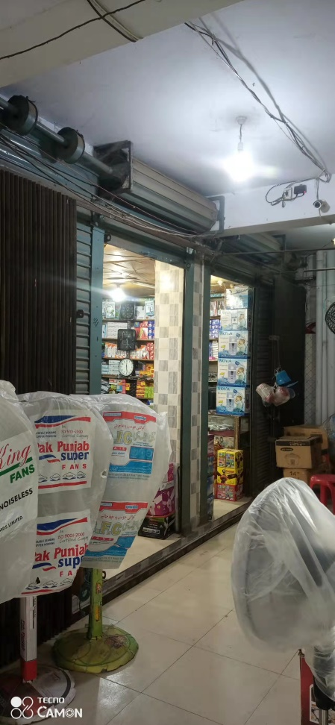
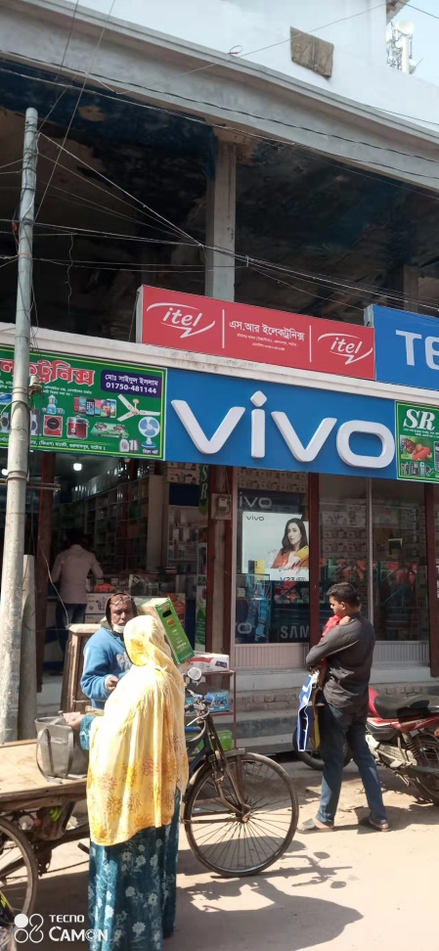
Gurudaspur Thana Market (GRT)
CD Sound :
Sales Universe: 50
R SO: 7
V SO: 6
O SO: 4
S SO: 6
X SO: 3
T SO: 2
I SO: 2
Others: 20
Galaxy :
Sales Universe: 89
R SO: 11
V SO: 8
O SO: 22
S SO: 28
X SO: 7
T SO: 3
I SO: 2
Others:18
Momtaj Telecom :
Sales Universe:55
R SO: 5
V SO: 4
O SO: 5
S SO:11
X SO:6
T SO: 4
I SO: 3
Others:17
Siddik Telecom:
Sales Universe:36
R SO: 4
V SO: 5
O SO: 4
S SO: 6
X SO:3
T SO: 2
I SO: 2
Others:10
Sikreeti Times :
Sales Universe:23
R SO: 3
V SO: 0
O SO: 2
S SO:4
X SO:2
T SO: 2
I SO: 2
Others:8
SR Telecom:
Sales Universe:82
R SO: 11
V SO: 15
O SO: 8
S SO:18
X SO:5
T SO: 5
I SO: 5
Others: 15
GRT Shop:
TTL 6 realme GRT Shop
TTL GRT Sale: 335 Pcs
Plan: Some Sticker Branding

Slide 21
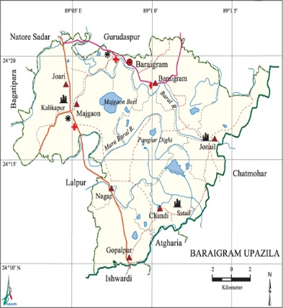
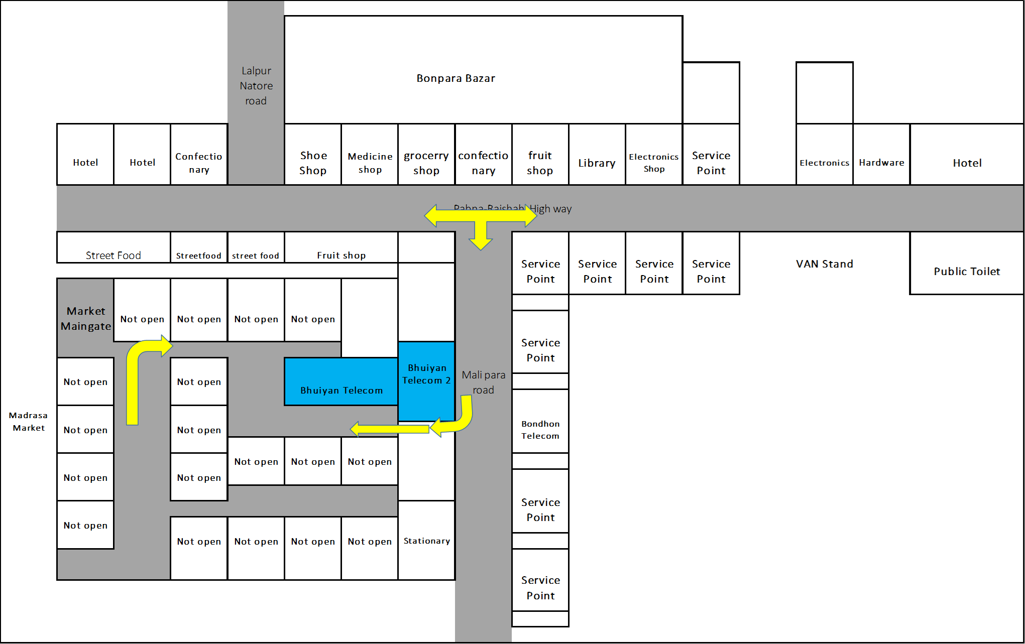
Boraigram Thana Market:
A. Market Review
Sales Universe: 515
R SO: 64
R MKT Share: 12.42%
V SO:99
V MKT Share:19.28%
O SO:72
O MKT Share:13.98% X SO:36
X MKT Share:6.99%
S SO:59
S MKT Share:11.45%
T SO:34
T MKT Share:6.53%
I SO:31
I MKT Share:5.95%
Other:120
I MKT Share:23.30%
B. Retail Universe: 8
R WOD: 8
V WOD-6
O WOD: 8
X WOD: 5 S WOD:8
T WOD: 4
I WOD: 4
Others WOD: 8
C. BS Universe: 0
R BS: 0
R BS Share: 0
V BS: 0
V BS Share: 0
O BS: 0
O BS Share:0 X BS: 0
X BS Share:0
S BS: 0
S BS Share:0
T BS:0
I BS: 0
Other: 0
D. CS Universe: 0
R CS: 0
R CS Share:0
V CS:0
V CS Share:
O CS:0
O CS Share:0 X CS: 0
X CS Share: 0
S CS: 0
S CS Share: 0
T CS: 0
T CS Share: 0
I CS: 0
I CS Share: 0
Other: 0
Others CS Share:0
E. GRT Universe: 8
R GRT: 8(64pcs)
R GRT Share: 100%
V GRT: (99pcs)
V GRT Share: 750%
O GRT:8(72pcs)
O GRT Share: 100% X GRT: 5(36 pcs)
X GRT Share: 62.5%
S GRT: 8(59 pcs)
S GRT Share: 100%
T GRT: 4 (34pcs)
T GRT Share: 50%
I GRT: 4(31pcs)
I GRT Share: 50%
Other: 8 (120pcs)
Others GRT Share:100%
F. realme Dealer: 1
TTL Investment: 90Lac
Inventory: 9.5 Lac
TTL Market due: 7Lac
Lalpur Market Due: .75 lac
G. realme RSM: 1
realme ASM: 1
TSM: 1
Main market – Natore Distance
Market Map –BoraigramThana

Slide 22
Boraigram Thana Market (BS)
No Brand shop

Slide 23
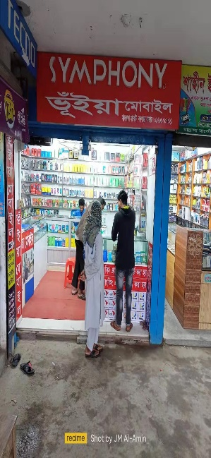
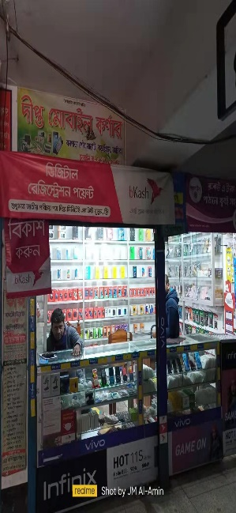
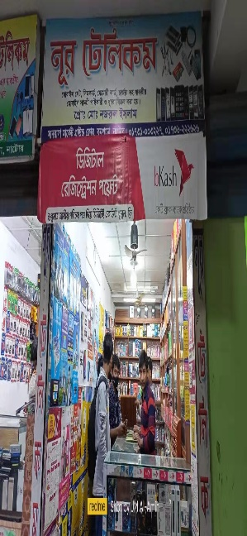
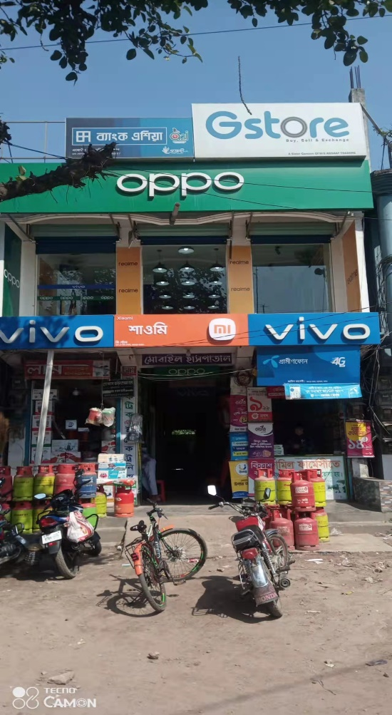
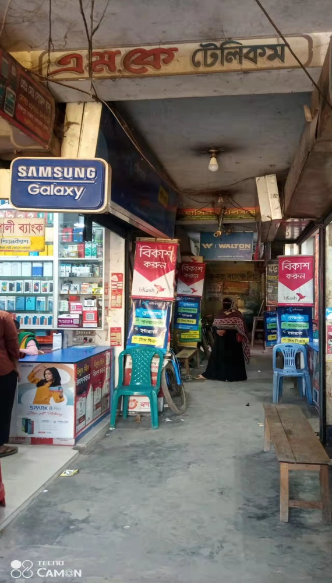
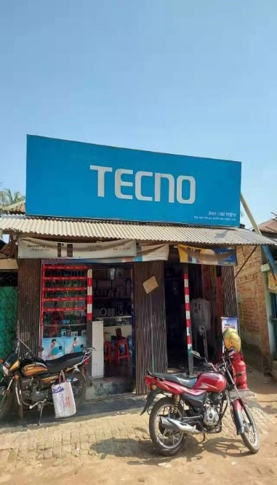
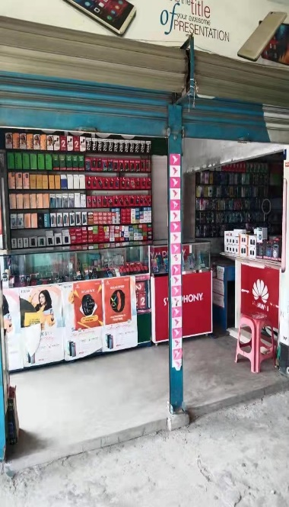
Boraigram Thana Market (GRT)
Bhuiyan Mobile:
Sales Universe: 125
R SO: 35
V SO: 25
O SO: 20
S SO: 12
X SO: 10
T SO: 7
I SO: 5
Others: 20
Dipto Mobile :
Sales Universe: 47
R SO: 7
V SO: 5
O SO: 3
S SO: 7
X SO: 5
T SO: 3
I SO: 2
Others:15
Noor Telecom:
Sales Universe:36
R SO: 4
V SO: 5
O SO: 4
S SO: 6
X SO:3
T SO: 2
I SO: 2
Others:10
G-Store :
Sales Universe:119
R SO: 15
V SO: 25
O SO: 20
S SO:22
X SO:10
T SO: 8
I SO: 7
Others:12
MK Mobile:
Sales Universe:58
R SO: 9
V SO: 10
O SO: 7
S SO:10
X SO:5
T SO: 4
I SO: 3
Others: 10
Molla Mobile:
Sales Universe:52
R SO: 5
V SO: 4
O SO: 5
S SO:7
X SO:6
T SO: 4
I SO: 3
Others:17
Hridro Mobile:
Sales Universe:78
R SO: 9
V SO: 8
O SO: 7
S SO:6
X SO:7
T SO: 7
I SO: 6
Others:28
GRT Shop:
TTL 8 realme GRT Shop
TTL GRT Sale: 515 Pcs
Plan: Some Sticker Branding , Signboard

Slide 24


Bagatipara Thana Market:
A. Market Review
Sales Universe: 308
R SO: 41
R MKT Share: 13.31%
V SO:73
V MKT Share:23.59%
O SO:40
O MKT Share:12.88% X SO:17
X MKT Share:5.62%
S SO:34
S MKT Share:11.14%
T SO:14
T MKT Share:4.65%
I SO:11
I MKT Share:3.46%
Other:78
I MKT Share:25.32%
B. Retail Universe: 6
R WOD: 6
V WOD-4
O WOD: 6
X WOD: 4 S WOD:6
T WOD: 4
I WOD: 3
Others WOD: 6
C. BS Universe: 0
R BS: 0
R BS Share: 0
V BS: 0
V BS Share: 0
O BS: 0
O BS Share:0 X BS: 0
X BS Share:0
S BS: 0
S BS Share:0
T BS:0
I BS: 0
Other: 0
D. CS Universe: 0
R CS: 0
R CS Share:0
V CS:0
V CS Share:
O CS:0
O CS Share:0 X CS: 0
X CS Share: 0
S CS: 0
S CS Share: 0
T CS: 0
T CS Share: 0
I CS: 0
I CS Share: 0
Other: 0
Others CS Share:0
E. GRT Universe: 6
R GRT: 6(41pcs)
R GRT Share: 100%
V GRT: 4(73pcs)
V GRT Share: 80%
O GRT:6(40pcs)
O GRT Share: 100% X GRT: 4(17 pcs)
X GRT Share: 80%
S GRT: 6(34 pcs)
S GRT Share: 100%
T GRT: 4 (14pcs)
T GRT Share: 80%
I GRT: 3(11pcs)
I GRT Share: 50%
Other: 6 (78pcs)
Others GRT Share:100%
F. realme Dealer: 1
TTL Investment: 90Lac
Inventory: 6 Lac
TTL Market due: 7Lac
Lalpur Market Due: .25 lac
G. realme RSM: 1
realme ASM: 1
TSM: 1
Main market – Natore Distance
Market Map – Bagatipara Thana

Slide 25
Bagatipara Thana Market (BS)
No Brand shop

Slide 26




Bagatipara Thana Market (GRT)
Sarkar Telecom:
Sales Universe: 35
R SO: 4
V SO: 3
O SO: 3
S SO: 5
X SO: 5
T SO: 3
I SO: 2
Others:10
Sohan Enterprise:
Sales Universe:112
R SO: 11
V SO: 22
O SO: 17
S SO: 25
X SO:10
T SO: 7
I SO: 5
Others:15
Moom Telecom:
Sales Universe:68
R SO: 6
V SO: 16
O SO: 14
S SO:10
X SO:5
T SO: 4
I SO: 3
Others: 10
Boishakhi Telecom:
Sales Universe: 28
R SO: 3
V SO: 2
O SO: 2
S SO: 3
X SO: 5
T SO: 3
I SO: 2
Others:8
GRT Shop:
TTL 6 realme GRT Shop
TTL GRT Sale: 308 Pcs
Plan: Some Sticker Branding , Signboard

Slide 27
Thanks

